Slide 1
Lecture 6
Algorithmic Trading
Robert Kissell
Robert.Kissell@baruch.cuny.edu
Fall 2017

Slide 2
Lecture 6: Algorithmic Trading
Algorithmic Trading
Market Impact Model
Data Requirements
Functional Form vs. Machine Learning
How do we test models, and predictive data?
Final Project Review
Final Project Due Friday 12/15/2017

Slide 3
What is Algorithmic Trading

Slide 4
What is Algorithmic Trading?
Algorithmic trading is the computerized (automated) execution of financial instruments following pre-specified rules and guidelines .
These pre-specified rules include: Macro Rules, Micro Rules, Limit Order Modeling, and Smart Ordre Routing.
A goal of algorithmic trading is to reduce overall transaction costs and to ensure that the trading goal is consistent with the investment objective of the fund.
To reduce and manage transaction costs, algorithms will slice orders into smaller pieces and trade over time.

Slide 5
How much trading is Algorithmic?

Slide 6
Types of Algorithmic Trading
Algorithmic Trading
Execution Algorithm
HFT
Algorithm
Trading, Execution, Implementation
Algorithm executes a trade or order that was determined by a Manager or Trader outside of the algorithm.
Proprietary Trading
Algorithm determines what to buy or sell, and also the actual execution strategy for that trade or order.

Slide 7
Classification of Algorithms
Aggressive: Get Me Done. Sweep all Liquidity available at My Price or Better.
Working Orders: Balance the tradeoff between cost and risk, manage placement of market and limit orders. VWAP/TWAP, POV, IS (Implementation Shortfall), Inline.
Passive: Usage of crossing systems and dark pools. Liquidity Seeking Algorithms.

Slide 8
Types of Trading Algorithms
VWAP – the algorithm will slice the order over a period of time based on historical volume profiles. The goal is to achieve the volume weighted average price over a period of time.
POV – the algorithm will participate with volume at a specified percentage of volume, e.g., POV=15%. If there is more market volume the order will complete early and if there is less market volume the order will take long to complete.
Arrival Price – the algorithm will often front-load trades at the beginning of execution and taper-off at the end in order to execute more shares closer to the arrival price (price when we started to trade).
Optimal – the algorithm determine the “optimal” execution strategy that balances the trade-off between price impact and timing risk. Optimal trading algorithms usually result in front-loaded algorithms.
Front-Loaded – the algorithm will trade more of the order at the beginning of the trading horizon and will slow down over time. The rate of slowing down is dependent on the optimal strategy selected.
Dynamic – the algorithm will adapt in real-time to changing stock prices and market conditions, and as a result will speed up or slow down in order to best take advantage of market conditions.
HFT – High Frequency Trading Algorithms will determine what, when, and where to buy and sell stocks to earn a trading profit. Many times these algorithms are based on statistical arbitrage models and/or based on liquidity trading where they seek to earn a rebate from providing market liquidity. E.g., buy shares now with the anticipation of selling a later time and at a higher price.
DMA – Direct Market Access (DMA). Brokers provide connectivity to different market venues, exchanges, ATS, and dark pools. Investors design their own trading strategies and algorithmic trading rules, and submit orders via these direct market access (DMA) connections.

Slide 9
VWAP Algorithm

Slide 10
POV Algorithm

Slide 11
POV Algorithm

Slide 12
POV Algorithm

Slide 13
Arrival Price (Front-Loaded) Algorithm

Slide 14
Arrival Price (Front-Loaded) Algorithm

Slide 15
What Are Transaction Costs?

Slide 16
What are Transaction Costs?
Economic: dollars paid by buyers but not received by sellers and dollars paid by sellers but not received by buyers.
Financial: dollars amount paid above the decision price (premium) for buy orders and dollars amount paid below the decision price (discount) for sell orders.
Transaction costs are an unavoidable cost of business.
What are some examples of transaction costs in business?

Slide 17
Transaction Cost Iceberg
Depiction of the Iceberg to illustrate Transaction Costs was introduced by Wayne Wagner, The Plexus Group.
Transaction Cost Iceberg
Commissions, Taxes, Fees &
Spreads
Market Impact,
Opportunity, Delay Cost,
Trend &
Timing Risk

Slide 18
Transaction Cost Decomposition
Commissions
Fess & Rebates
Taxes
Spreads
Delay
Market Impact
Price Appreciation
Timing Risk
Opportunity Cost

Slide 19
Trading Process
Investment Goals
Macro Trading Goals
Micro Decisions
Limit Order Models
Smart Order Router

Slide 20
Exchanges, Venues, & Dark Pools

Slide 21
Trading Venues
Trading Venues
Stock Exchange
ATS Venue
Crossing Network
Dark Pool

Slide 22
Trader’s Dilemma

Slide 23
Trader’s Dilemma:
Trader’s Dilemma
Trading too aggressively will cause high market impact (low timing risk) but trading too passively will cause high price risk (low market impact cost).
Market Impact and Timing Risk are conflicting expressions.

Slide 24
Trader’s Dilemma Optimization

Slide 25
Solving Trader’s Dilemma
Traders seek to manage the tradeoff between market impact cost and timing risk at a specified level of risk aversion λ.

Slide 26
Trader’s Dilemma Optimization

Slide 27
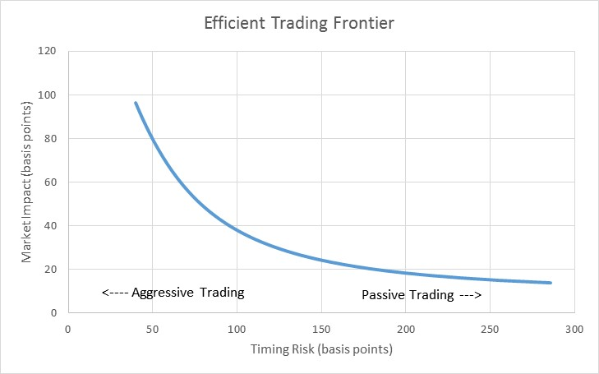
Efficient Trading Frontier (Almgren & Chriss 1997)

Slide 28
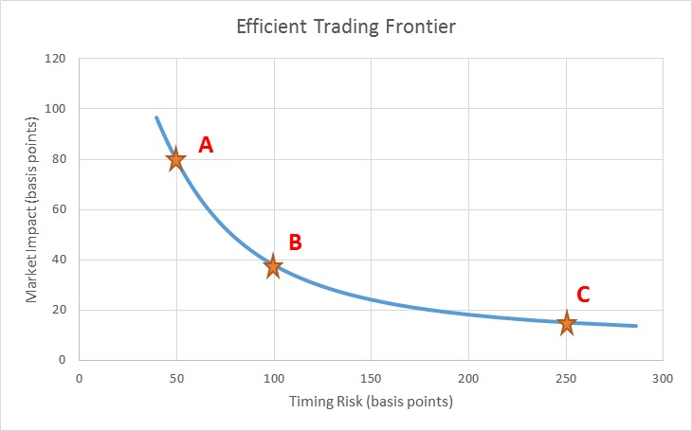
Efficient Trading Frontier (Optimal Trading Strategies)

Slide 29
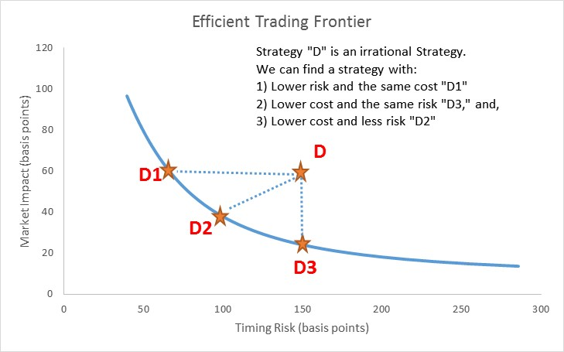
Efficient Trading Frontier (Irrational Strategy)

Slide 30
Market Impact

Slide 31
What is Market Impact?
Market Impact is the price movement in a stock caused by the order or trade.
MI consists of two components: temporary and permanent.
Temporary impact is due to the liquidity needs of the investor. Temporary impact cost can be managed via the trading strategy and is a controllable cost.
Permanent impact is due to the information content of the trade. Permanent impact is an unavoidable cost of trading.
Mathematically, MI is defined as the difference between the path of the stock with and without the order.
Since we are not able to observe both paths simultaneously, market impact has been referred to has the “Heisenberg Uncertainty Principal of Finance.”

Slide 32
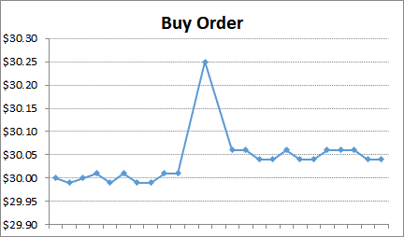
Market Impact: Buy Order Illustration
Ananth Madhavan Formulation (2000, 2002)

Slide 33
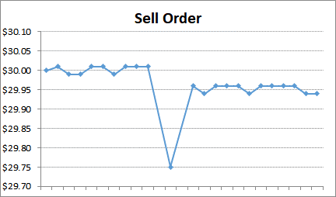
Market Impact: Sell Order Trade Illustration
Ananth Madhavan Formulation (2000, 2002)

Slide 34
Market Impact: Supply Demand Illustration

Slide 35
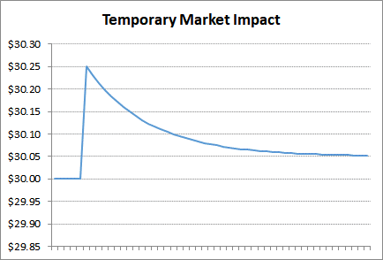
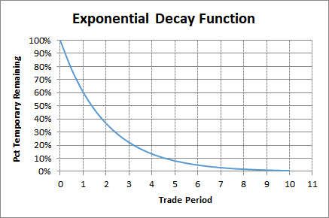
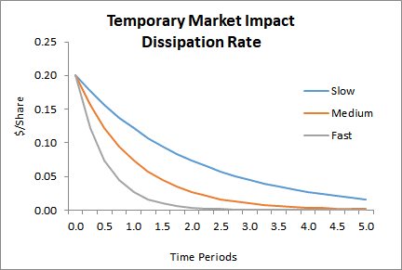
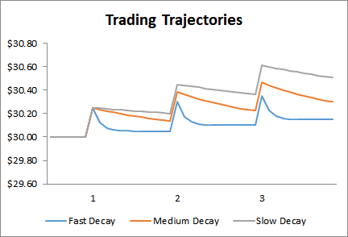
Temporary Dissipation Illustration

Slide 36
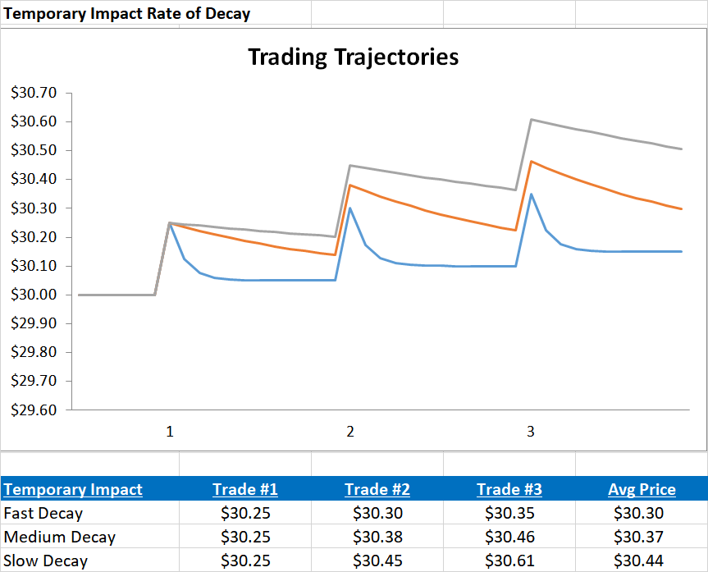
Temporary Dissipation Costs

Slide 37
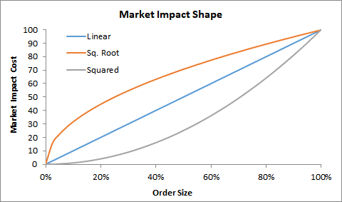
Market Impact Shape

Slide 38
Market Impact Models

Slide 39
Market Impact Models
Path Dependent Approach
Almgren & Chriss (2000)
Bottom Up
Cost Allocation Approach
Kissell & Malamut (2001)
I-Star Model
Top Down

Slide 40
Path Dependent
Almgren & Chriss (1997)

Slide 41
Random Walk with Price Drift – Discrete Time Periods
Starting Price,
$$P_{0}=Current Price$$
First Price,
$$P_{1}=P_{0}+∆P_{1}+ε_{1}$$
Second Period,
$$P_{2}=P_{1}+∆P_{2}+ε_{2}$$
By substitution we have,
$$P_{2}=P_{1}+∆P_{2}+ε_{2}=\left(P_{0}+∆P_{1}+ε_{1}\right)+∆P_{2}+ε_{2} \\ =P_{0}+∆P_{1}+∆P_{2}+ε_{1}+ε_{2}$$
This can also be written as:
$$P_{2}=P_{0}+\sum_{j=1}^{2}{∆P_{j}}+\sum_{j=1}^{2}{ε_{j}}$$
Price after k-periods,
$$P_{k}=P_{0}+\sum_{j=1}^{k}{∆P_{j}}+\sum_{j=1}^{k}{ε_{j}}$$

Slide 42
Random Walk with Market Impact
Let, $P_{0}$= arrival price, $f\left(x_{k}\right)$ = temporary impact from $x_{k}$shares, $g\left(x_{k}\right)$ = permanent impact from $x_{k}$shares, and
$ε$ is random noise.
Then,
$$P_{1}=P_{0}+f\left(x_{1}\right)+g\left(x_{1}\right)+ε_{1}$$
$$P_{2}=P_{1}+f\left(x_{2}\right)+g\left(x_{2}\right)−\{f\left(x_{1}\right)∙\left(1−e^{−γ∙1}\right)\}+ε_{2}$$
$f\left(x_{1}\right)∙\left(1−e^{−γ∙1}\right)$ represents the reduction of temporary market impact from the first trade.
Substitution,
$$P_{2}=\left\{P_{0}+f\left(x_{1}\right)+g\left(x_{1}\right)+ε_{1}\right\}+\left\{f\left(x_{2}\right)+g\left(x_{2}\right)\right\}−\{f\left(x_{1}\right)∙\left(1−e^{−γ∙1}\right)\}+ε_{2}$$
This reduced to:
$$P_{2}=P_{0}+\underset{Cumulative Temporary}{\underbrace{\left\{f\left(x_{2}\right)+f\left(x_{1}\right)∙e^{−γ∙1}\right\}}}+\underset{Cumulative Permanent}{\underbrace{\left\{g\left(x_{1}\right)+g\left(x_{2}\right)\right\}}}+\underset{Cumulative Noise}{\underbrace{\{ε_{1}+ε_{2}\}}}$$
where $f\left(x_{1}\right)∙e^{−γ∙1}$ is the remaining temporary impact from the first trade.

Slide 43
Random Walk with Market Impact

Slide 44
I-Star Model
(Kissell & Malamut 1997)

Slide 45
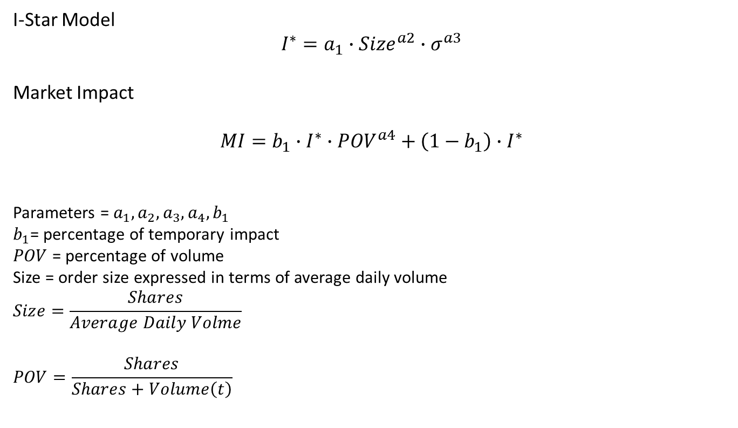
I-Star Model Derivation
I-Star Model
$$I^{∗}=a_{1}∙Size^{a2}∙σ^{a3}$$
Market Impact
$$MI=b_{1}∙I^{∗}∙POV^{a4}+\left(1−b_{1}\right)∙I^{∗}$$
Parameters = $a_{1}, a_{2}, a_{3}, a_{4}, b_{1}$
$b_{1}$= percentage of temporary impact
$POV$ = percentage of volume
Size = order size expressed in terms of average daily volume
$$Size=\frac{Shares}{Average Daily Volme}$$
$$POV=\frac{Shares}{Shares+Volume\left(t\right)}$$

Slide 46
Explanatory Factors

Slide 47
Market Impact Variables

Slide 48
Market Impact Model Verification

Slide 49
Transaction Cost Relationships

Slide 50
Market Impact as function of Order Size (Basis Points)

Slide 51
Market Impact as function of Order Size (Dollars)

Slide 52
Market Impact as function of Volatility

Slide 53
Market Impact as function of Trade Time

Slide 54
Market Impact as function of POV Rate

Slide 55
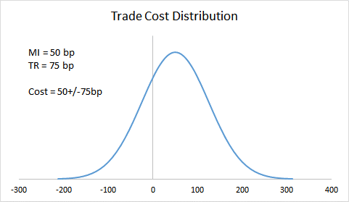
Trading Cost Distribution

Slide 56
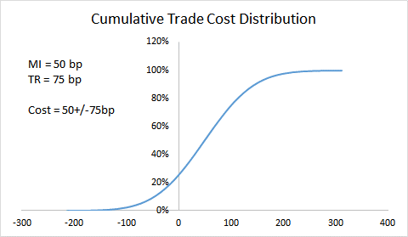
Cumulative Trading Cost Distribution

Slide 57
Market Impact as Function of Size

Slide 58
Market Impact as Function of Size

Slide 59
Market Impact Relationships

Slide 60
Timing Risk

Slide 61
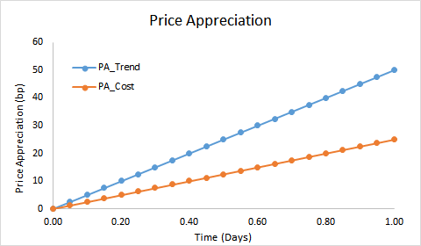
Price Appreciation

Slide 62
Excel Spreadsheet Examples

Slide 63
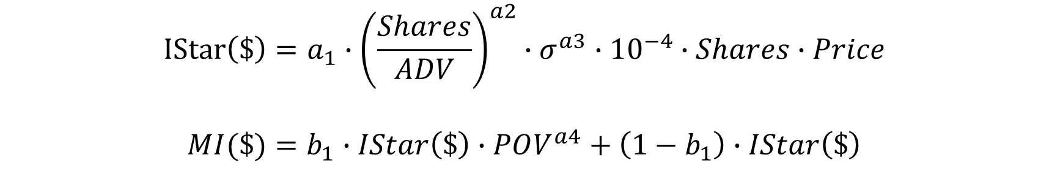
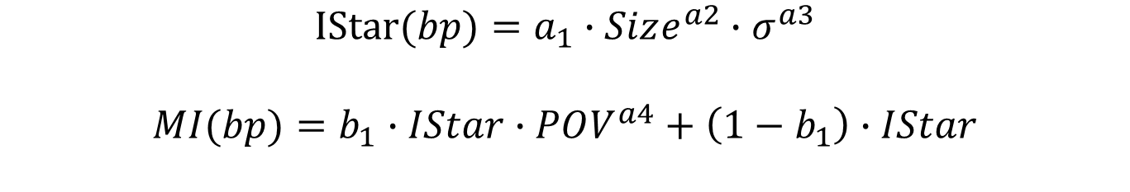
Market Impact Formula
$$IStar(bp)=a_{1}∙Size^{a2}∙σ^{a3}$$
$$MI(bp)=b_{1}∙IStar∙POV^{a4}+\left(1−b_{1}\right)∙IStar$$
$$IStar\left(\$\right)=a_{1}∙{\left(\frac{Shares}{ADV}\right)}^{a2}∙σ^{a3}∙{10}^{−4}∙Shares∙Price$$
$$MI(\$)=b_{1}∙IStar\left(\$\right)∙POV^{a4}+\left(1−b_{1}\right)∙IStar\left(\$\right)$$

Slide 64

Timing Risk Formula
$$TR(bp)=σ∙\sqrt{\frac{1}{250}∙\frac{1}{3}∙Time}∙{10}^{4}$$
$$TR(bp)=σ∙\sqrt{\frac{1}{250}∙\frac{1}{3}∙\left(Size∙\frac{1−POV}{POV}\right)}∙{10}^{4}$$
$$TR(\$)=σ∙\sqrt{\frac{1}{250}∙\frac{1}{3}∙\left(\frac{Shares}{ADV}∙\frac{1−POV}{POV}\right)}∙Shares∙Price$$

Slide 65

Price Appreciation Formula
$$PA\left(bp\right)=\frac{1}{2}∙Alpha∙Time$$
$$PA(bp)=\frac{1}{2}∙Alpha∙\left(Size∙\frac{1−POV}{POV}\right)$$
$$PA(\$)=\frac{1}{2}∙Alpha∙\left(\frac{Shares}{ADV}∙\frac{1−POV}{POV}\right)∙Shares∙Price$$

Slide 66
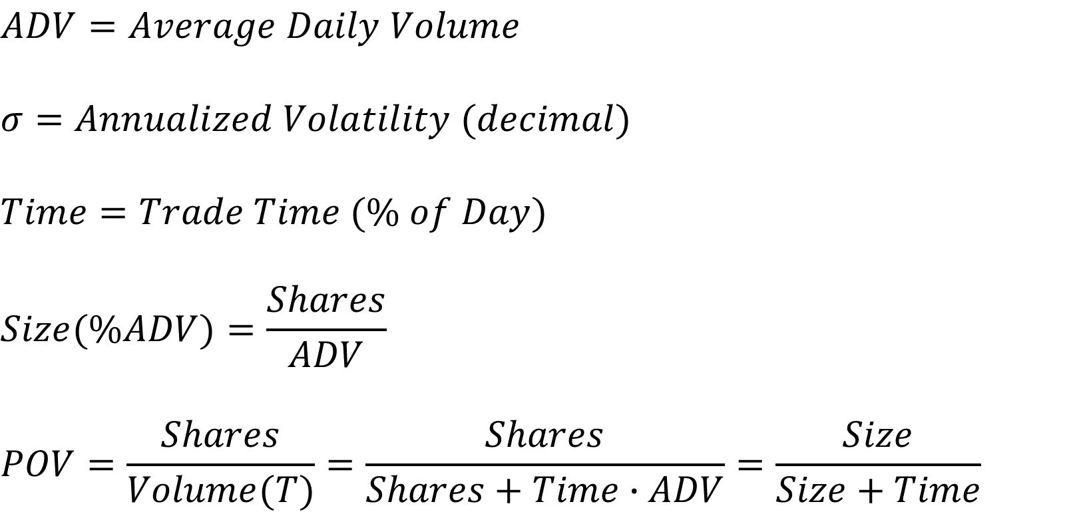
Important Formulas
$$ADV=Average Daily Volume$$
$$σ=Annualized Volatility (decimal)$$
$$Time=Trade Time (\% of Day)$$
$$Size(\%ADV)=\frac{Shares}{ADV}$$
$$POV=\frac{Shares}{Volume(T)}=\frac{Shares}{Shares+Time∙ADV}=\frac{Size}{Size+Time}$$

Slide 67
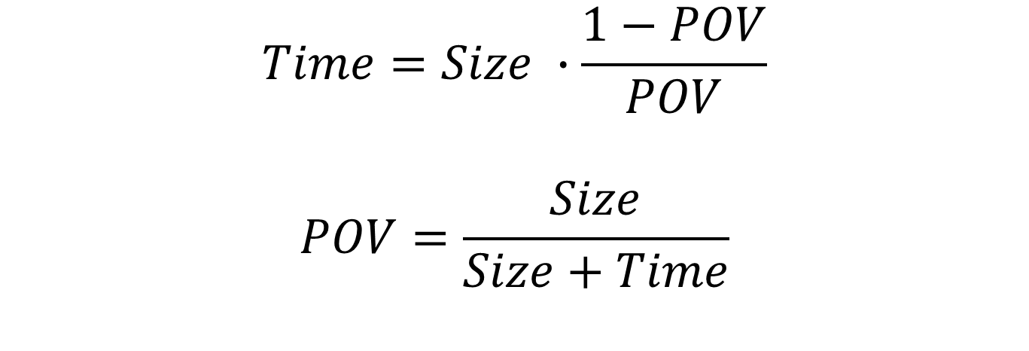
Important Formulas - Conversion
$$Time=Size ∙\frac{1−POV}{POV}$$
$$POV=\frac{Size}{Size+Time}$$

Slide 68
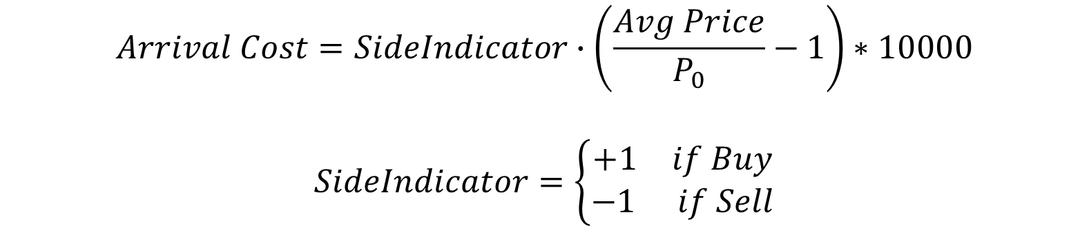
Arrival Cost / Realized Cost
$$Arrival Cost=SideIndicator∙\left(\frac{Avg Price}{P_{0}}−1\right)∗10000$$
$$SideIndicator=\left\{\begin{aligned}\begin{matrix}+1 & if Buy\end{matrix} \\ \begin{matrix}−1 & if Sell\end{matrix}\end{aligned}\right.$$

Slide 69
Transaction Cost Components as Function of Time

Slide 70
Market Impact Cost as a Function of Trade Time

Slide 71
Timing Risk as a Function of Trade Time

Slide 72
Price Appreciation as a Function of Trade Time

Slide 73
Transaction Cost Components as a Function of Trade Time

Slide 74
Transaction Cost Components as a Function of Trade Time

Slide 75
Algorithmic Decision Making Framework

Slide 76
Algorithmic Trading Decision Making Framework
Investment Objective – The underlying investor portfolio. This is based on the risk-return characteristics of the investor and/or fund manager.
Select Macro Trading Goal – How the order is to be sliced over the trading day to manage the transaction cost components. This is also known as the Best Execution Strategy or the Optimal Trading Strategy given the investment objective of the fund. The macro strategy needs to be consistent with the investment objective of the fund.
Select Micro Trading Decisions – How the algorithm is the adapt to changing market conditions over the day. Investors can take advantage of price trends given their expectation of whether the trend will continue or reverse and their specific preference. The micro decision needs to adhere to the macro decision.
Limit Order Model (LOM) – Determine appropriate mix of market and limit orders, based on the macro/micro decision.
Smart Order Router (SOR) – Determine venues / dark pools with highest likelihood of executing orders, based on the LOM.

Slide 77
Best Execution
Best Execution is the process of determining the trading strategy that provides the fund with the greatest likelihood of achieving its investment goals.
The Best Execution strategy is determined at the beginning of trading using only information that is available at the time of the trade and during the trade.
Best Execution does not mean that you achieved the best price on the day.
Best Execution cannot be measured using a Monday Morning Quarterback mentality, e.g., evaluating trading after you know what happened.
Important Note: Most people are very good at telling you what you should have done after knowing what you should have done. E.g., traffic routes without GPS after you arrive at your destination, and Monday morning quarterback.

Slide 78
Trader’s Dilemma
Trader’s Dilemma:
Trading too fast causes too much market impact cost and trading too slow causes too much timing risk.
Unfortunately, market impact cost and timing risk are conflicting terms. As we reduce one expression we increase the other an vice versa. E.g., as we lower market impact cost the timing risk increases, and as we decrease timing risk we increase market impact cost.
The trick to solving the Traders Dilemma is to balance the trade-off between market impact cost and timing risk based on the investment objective of the fund.

Slide 79
Efficient Trading Frontier
Optimal Trading Strategy = a strategy that has the lowest market impact cost for the given level of timing risk and the least risk for a specified market impact cost.
Efficient Trading Frontier = the set of all optimal trading strategies.
If a strategy does not lie on the Efficient Trading Frontier then it is an irrational strategy because we can find an alternative strategy with:
i) Less Timing Risk with the same Market Impact
ii) Lower Market Impact and the same Timing Risk
iii) Both lower Market Impact and lower Timing Risk
If a strategy does not lie on the Efficient Trading Frontier it is not a Best Execution Strategy.

Slide 80
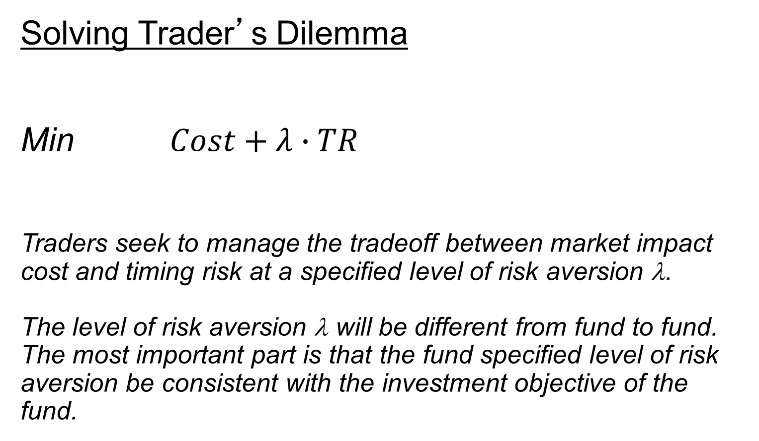
Solving Trader’s Dilemma Min $Cost+λ∙TR$ Traders seek to manage the tradeoff between market impact cost and timing risk at a specified level of risk aversion λ. The level of risk aversion λ will be different from fund to fund. The most important part is that the fund specified level of risk aversion be consistent with the investment objective of the fund.
Solving Trader’s Dilemma

Slide 81
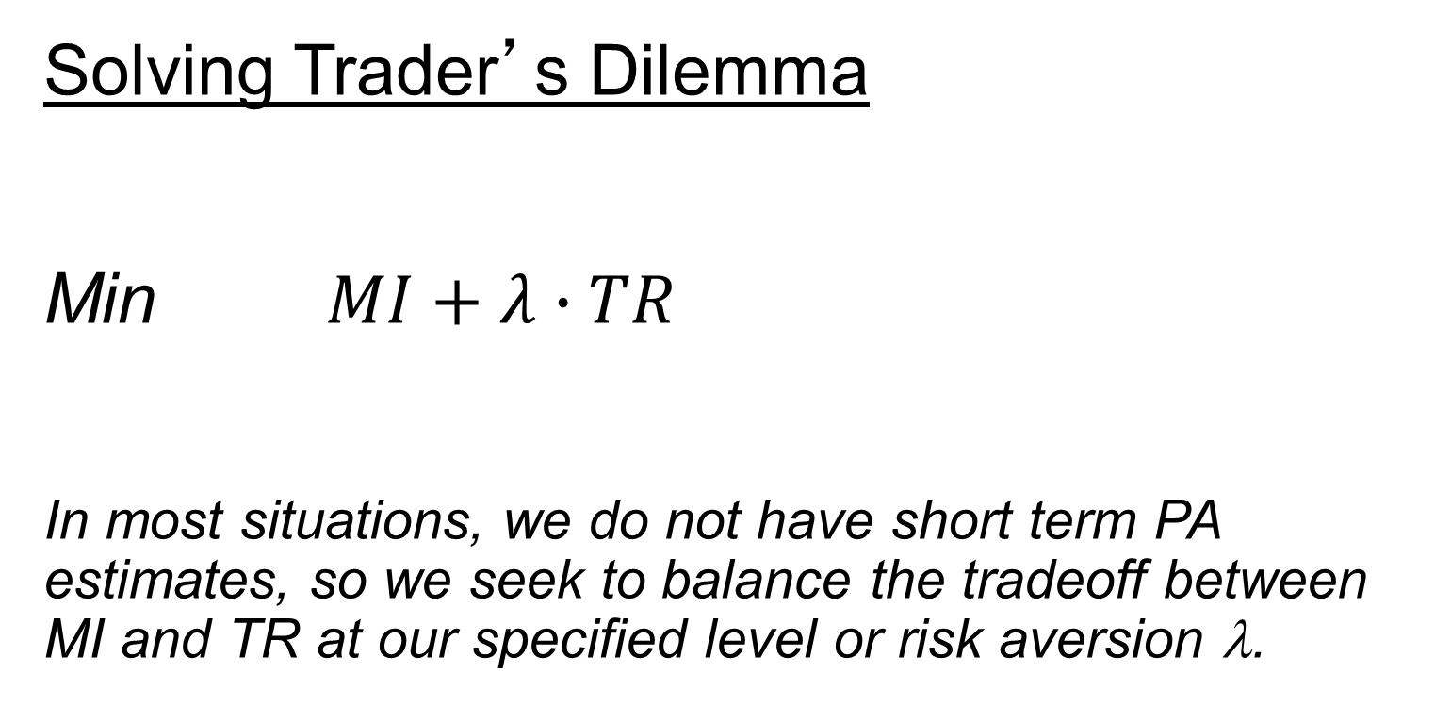
Solving Trader’s Dilemma Min $MI+λ∙TR$ In most situations, we do not have short term PA estimates, so we seek to balance the tradeoff between MI and TR at our specified level or risk aversion λ.
Solving Trader’s Dilemma

Slide 82
Solving Traders Dilemma

Slide 83
Efficient Trading Frontier (Almgren & Chriss 1997)

Slide 84
Efficient Trading Frontier (Optimal Trading Strategies)

Slide 85
Efficient Trading Frontier (Irrational Strategy)

Slide 86
Macro Decision Strategies – Best Execution Strategy

Slide 87
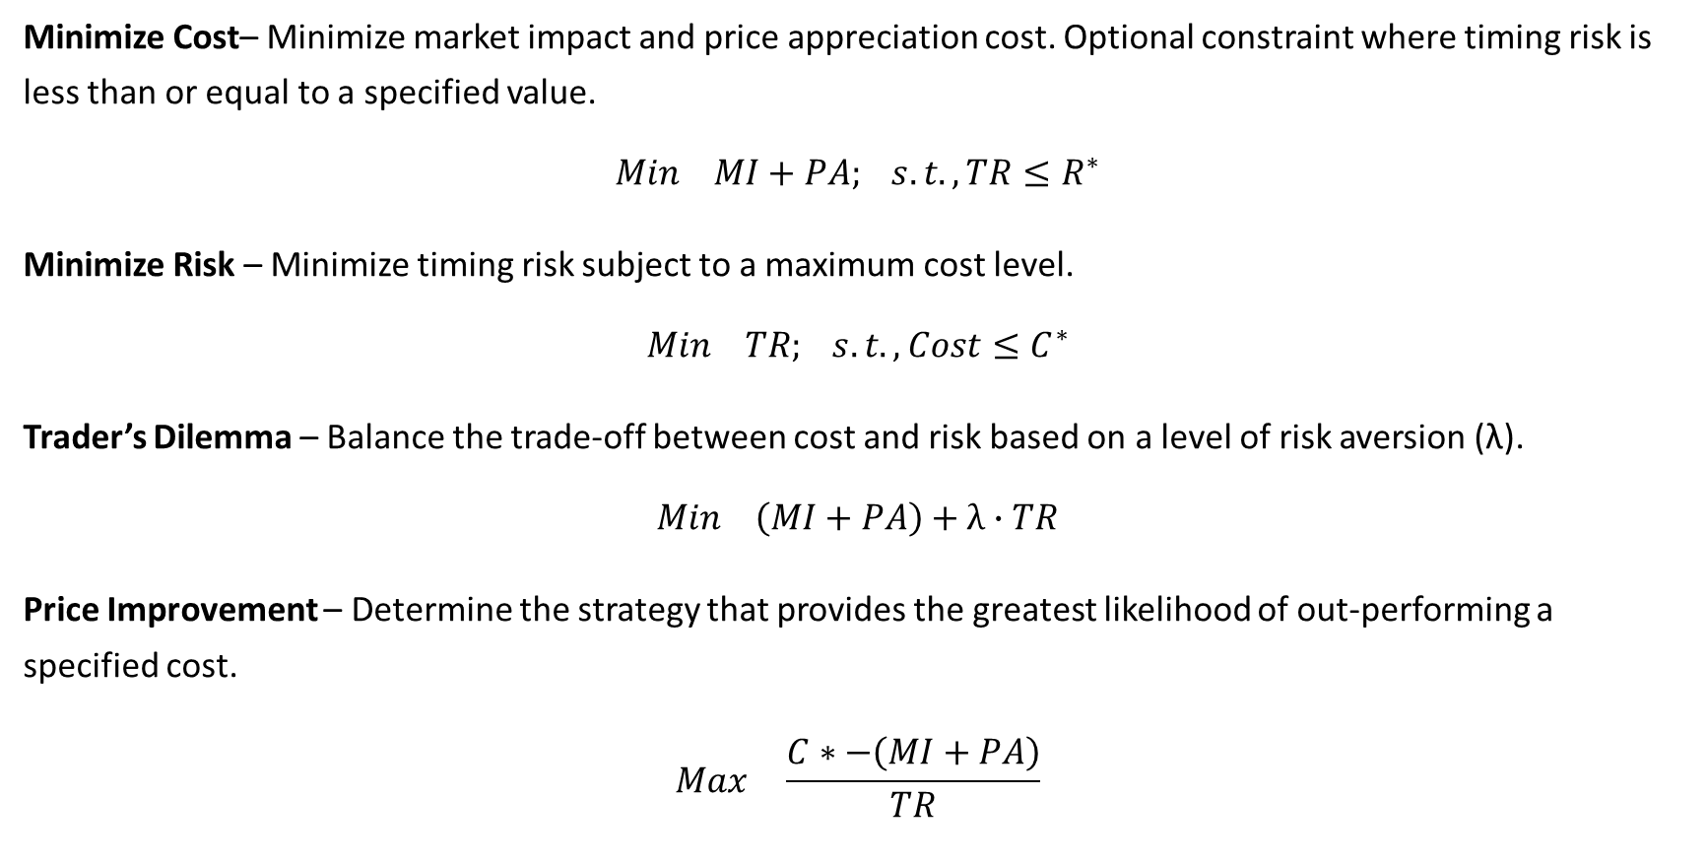
Macro Trading Goals – Best Execution Strategy
Minimize Cost– Minimize market impact and price appreciation cost. Optional constraint where timing risk is less than or equal to a specified value.
$$Min MI+PA; s.t., TR≤R^{∗}$$
Minimize Risk – Minimize timing risk subject to a maximum cost level.
$$Min TR; s.t., Cost≤C^{∗}$$
Trader’s Dilemma – Balance the trade-off between cost and risk based on a level of risk aversion (λ).
$$Min \left(MI+PA\right)+λ∙TR$$
Price Improvement – Determine the strategy that provides the greatest likelihood of out-performing a specified cost.
$$Max \frac{C∗−\left(MI+PA\right)}{TR}$$

Slide 88
Minimize Market Impact & Price Appreciation Cost

Slide 89
Minimize Market Impact & Price Appreciation Cost

Slide 90
Minimize Risk

Slide 91
Trader’s Dilemma

Slide 92
Trader’s Dilemma

Slide 93
Price Improvement

Slide 94
Price Improvement

Slide 95
Price Improvement

